Slide 1
Property Price in Venue Based Neighborhood Clustering
And Its Implication in Selection A New Venue Location

Slide 2
Background
Venue Based Clustering: similarity between neighborhoods as suggesting by the presence of similar type of venues
The underlying logic: larger presence of similar venues suggest concentrated demand for businesses

Slide 3
The Problem
Both the Whole Foods Market and C-Town Supermarkets fall under the "Supermarket" category
Whole Foods Market offers organic and preservatives-free products
C-Town offers lower price-points.
In this case, a pure-play venue based clustering algorithm would struggle
More factors should be taken into consideration:
Income: As approximately by neighborhood property sale prices

Slide 4
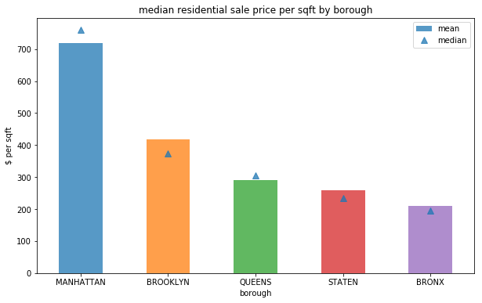
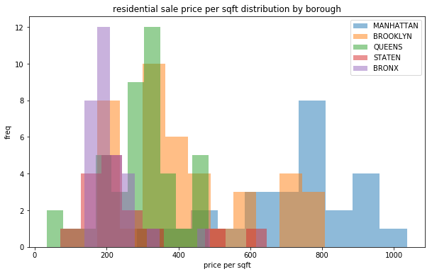
Looking at Property Sale Price Data

Slide 5
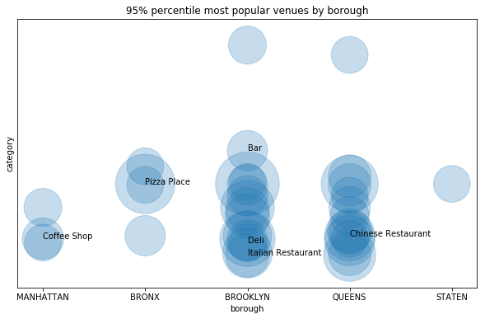
Looking at Venue Data
Bigger boroughs like Brooklyn and Queens have a more diversified mix of venues in their top 5% venues by number
Staple New York City venues like Pizza Place and Deli are among the top venues across boroughs
Coffee shops are Manhattan’s favorite by a long shot

Slide 6
What’s in a Popular
High End Neighborhood
Low End Neighborhood
Yoga Studio
French Restaurant
Clothing Store
Women’s Store
Cocktail Bar
Beach
Discount Store
Bus Stop
Fried Chicken Joint
Donut Shop

Slide 7
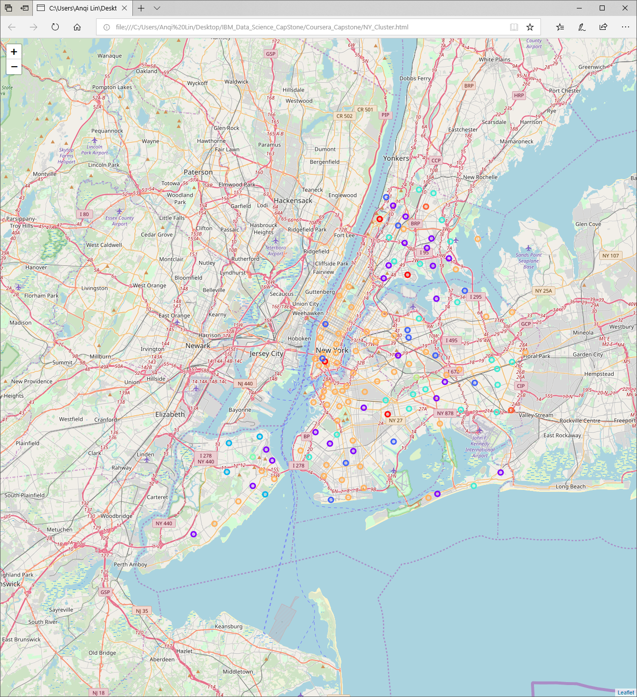
Clustering without Property Sale Data
Relatively scattered clusters
Overall Lower Accuracy

Slide 8
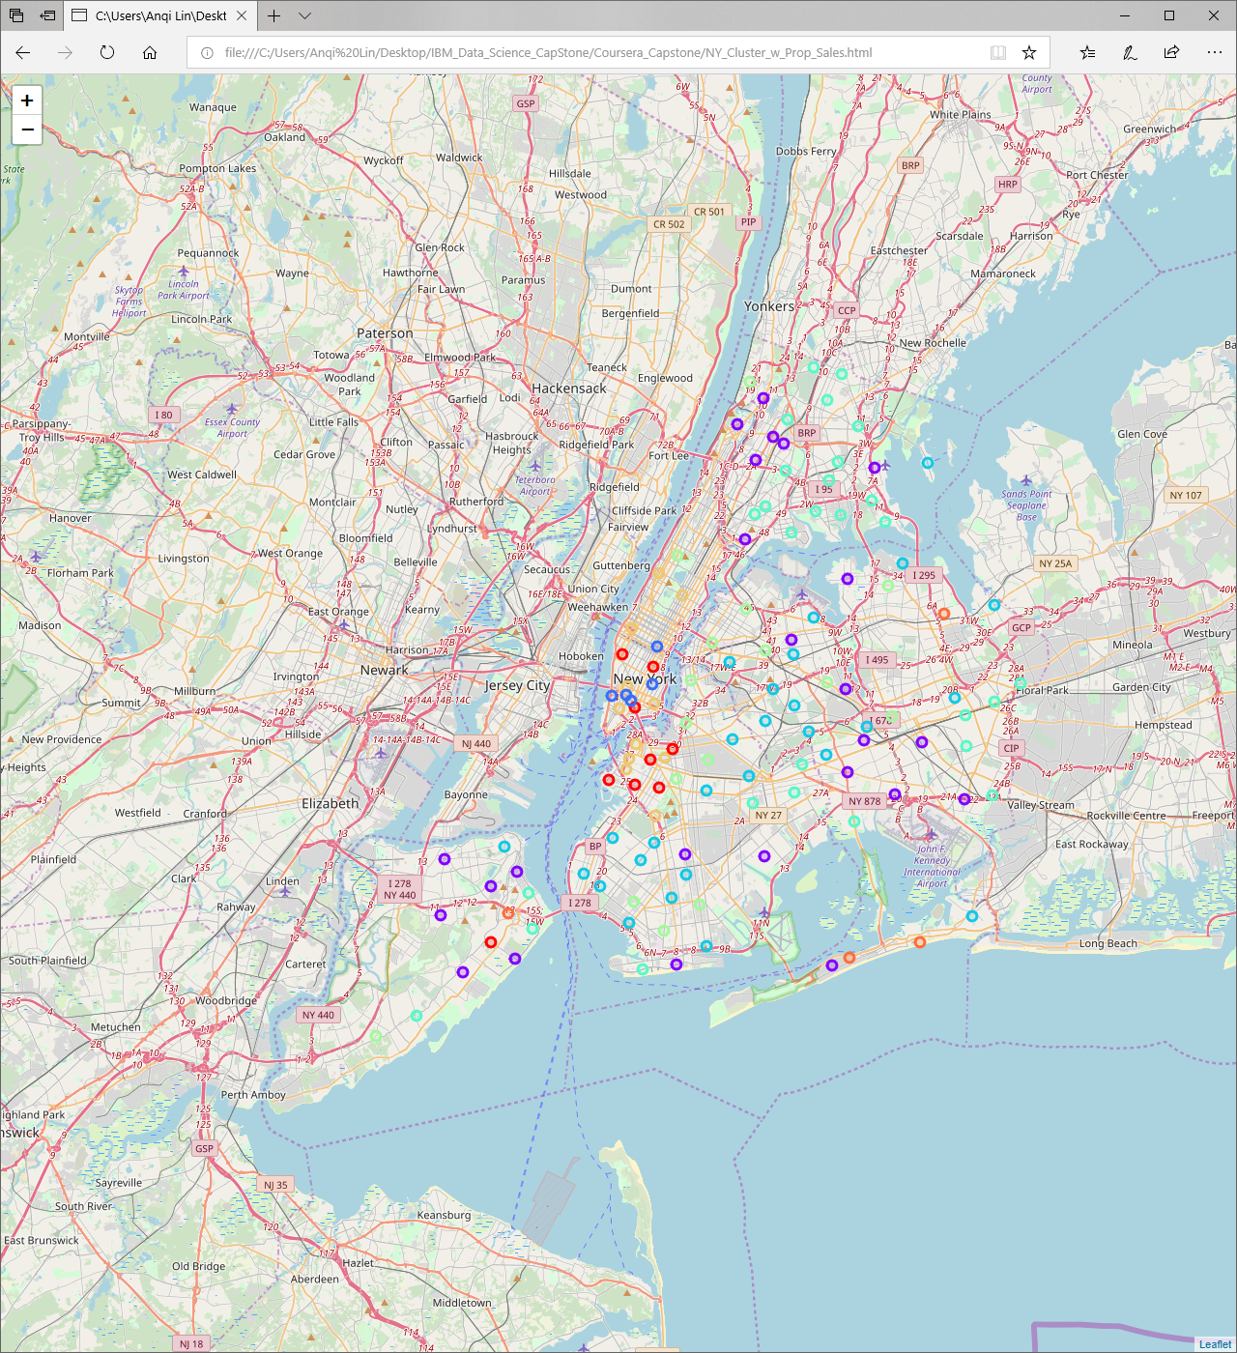
Clustering with Property Sale Data
Offers insight into distinctions between different neighborhoods of the same borough
Overall higher accuracy

